Slide 1
Machine Learning Project
Heart Failure and adverse event death

Slide 2
Dataset: Introduction and background
Cardiovascular Diseases kill annually over 16M people around the globe.
Clinical presentation is constellation of symptoms rendering the prediction of adverse event, death, difficult.
Computing sciences POWER is to reveal relevant features as predictors and predict death.
Better predictors would allow to better define line of care and treatment

Slide 3
Dataset
Reports a cohort of 299 patients who underwent previous heart failures which place them into advanced heart failure stages.
The clinical history contains the symptoms/status for: Sex, Age, Anaemia, High blood pressure, Diabetes, Smoking, CPK, Platelets, Serum creatinine, Serum sodium, Ejection fraction, Time

Slide 4
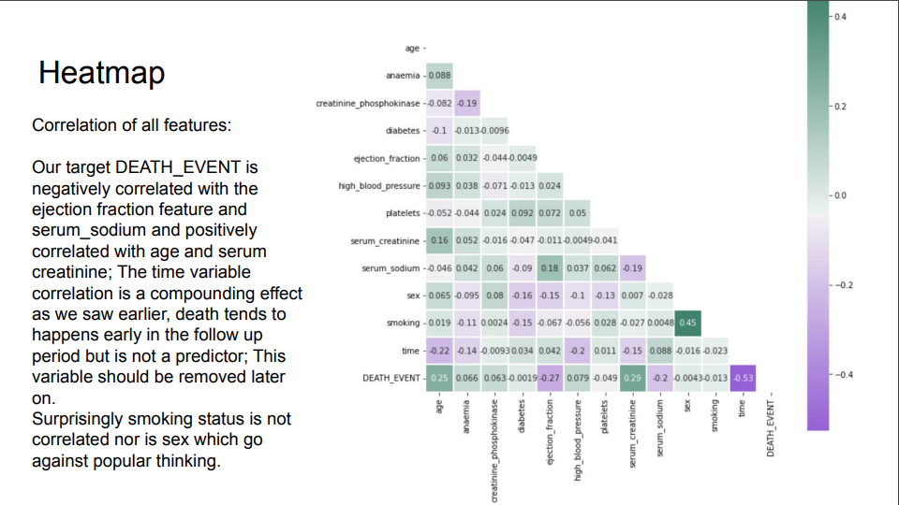

Slide 5
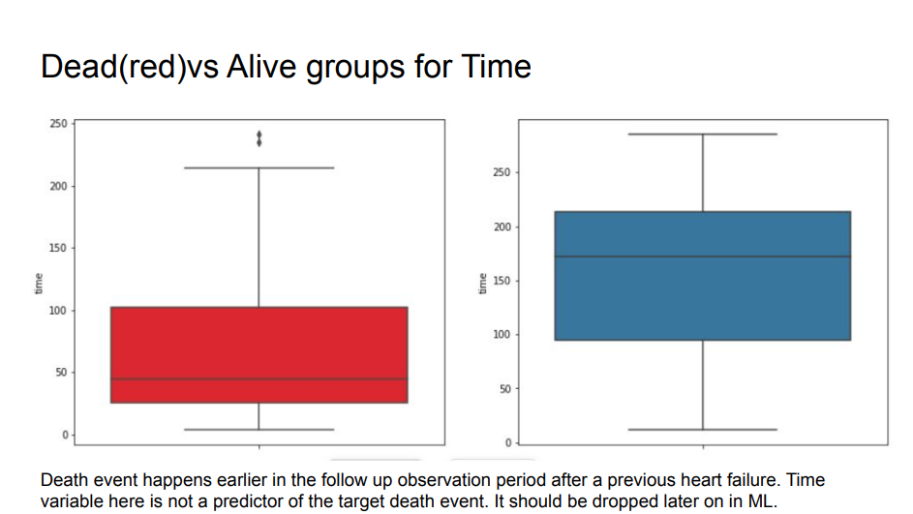

Slide 6
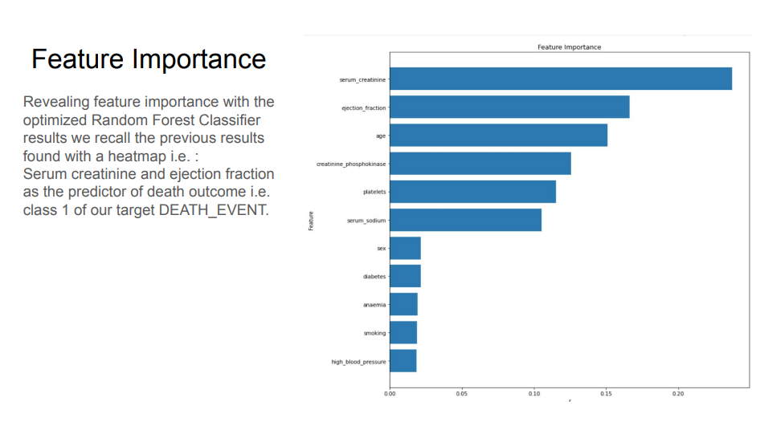

Slide 7
Conclusions
1- What is the type of problem we are trying to solve?
Predict DEATH_EVENT to better assist patient prognosis and treatment after heart failure.
We also want to reveal predictors to complement Drs expertise.

Slide 8
Conclusions
https://datascience.stackexchange.com/questions/9228/decision-tree-vs-knn
Random Forest Classifier is an "Eager Learner": when split/train/test, it first builds a classification model on the training dataset before being able to actually classify a hidden observation from the test dataset. This learned model is now "eager" (read hungry) to classify the unseen data points.
The KNN Classifier is a "Lazy Learner": it does not build any classification model, but directly learns from the training dataset and starts processing data only when it is given a test datapoint to classify.
Based on these characteristics, and in the long run in a medical office/hospital, as datasets grow slowly (patient per patient), the method called KNN worked better (our baseline accuracy is 69%, optimized KNN 74.11% ).

Slide 9
Conclusions
KNN is better suited for our project so far and to put in production.
Features of importance to predict the event of death are serum creatinine and ejection fraction. More discussion with subject experts are necessary to perhaps tweak our data better and improve our model better.
A downstream application of such predictive tool is too help a Dr assess faster a patient looking at the most relevant symptoms when the entire clinical history is not readily available in an ER room when life prognosis is engaged.

